Slide 1
Citi Bike Data Analysis
By Lautaro Sorzoni

Slide 2
Project Goal:
To better understand the behavior of Citi Bike’s customer base (both one-time users and subscribers) and how they use Citi Bikes.
This will help us to:
Identify where more bikes should be installed
Create targeted marketing campaigns that will appeal to different customer segments

Slide 3
Key questions:
What are the most popular pick-up locations across the city for Citi Bike rental?
How does the average trip duration vary across different age groups, and over time?
Which age group rents the most bikes?
How does bike rental vary across the two user groups (one-time users vs long-term subscribers) on different days of the week?
Do factors like weather and user age impact the average bike trip duration?

Slide 4
Findings & Insights

Slide 5
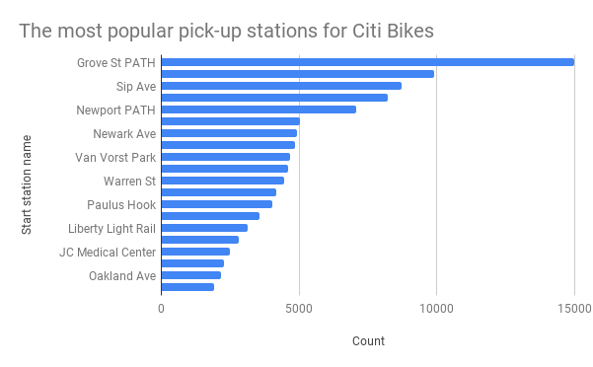
What are the most popular Citi Bike pick-up locations?
As we can see in this diagram, the top pick-up station is Grove St. PATH.
Followed by Sip Ave and Newport PATH.

Slide 6
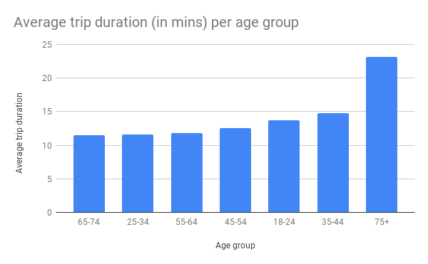
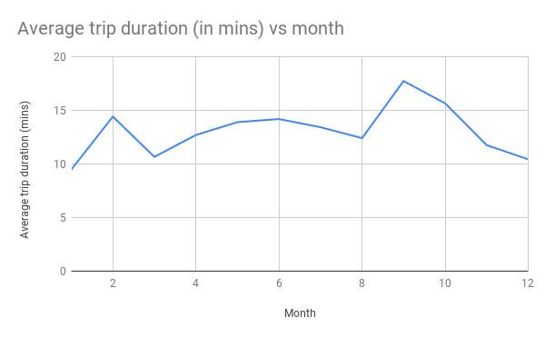
2a. How does the average trip duration vary across different age groups, and over time? *
* Detailed explanation in the next slide.

Slide 7
2b. How does the average trip duration vary across different age groups, and over time?
The Age Group that takes the longest trips (in minutes) is the people that is over 75 years, with an average time of 23 minutes per trip. Followed by the age group of people that is between 35 to 45 years old.
The months that have reflected the highest average trip duration are between August to March. The average drops around the end of December, and has a new rising at January, with a new peak in February.

Slide 8
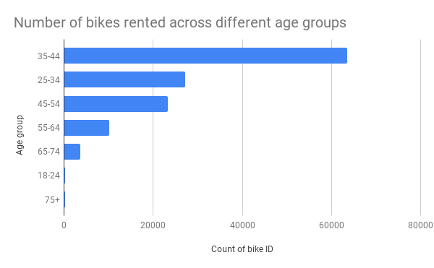
3. Which age group rents the most bikes?
The age group that rents the most bikes is the people that is between 35 to 44 years old, with an average of over 63.500 rents.
This group is followed by the people that has between 25 to 34 years old, with an average rents of over 27.000.

Slide 9
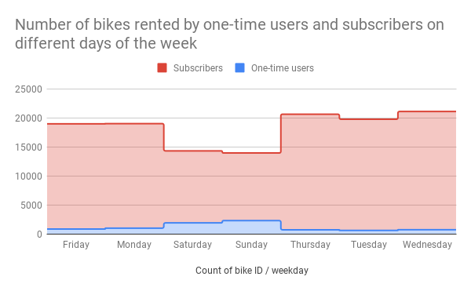
4a. How does bike rental vary across the two user groups (one-time users vs long-term subscribers) on different days of the week? *
* Detailed explanation in the next slide.

Slide 10
4b. How does bike rental vary across the two user groups (one-time users vs long-term subscribers) on different days of the week?
Analysis shows that the long-term subscribers rent the most quantity of bikes between Thursday and Monday, peaking on Thursday and Wednesday.
On the other hand, one-time users rent the most quantity of bikes on Saturday and Sundays, peaking on Sundays.
This graphic also illustrates that the vast majority of users of the service are long-term subscribers.

Slide 11
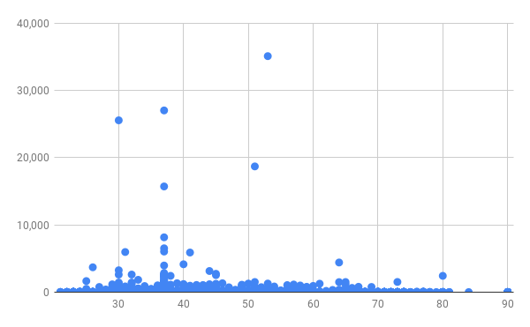
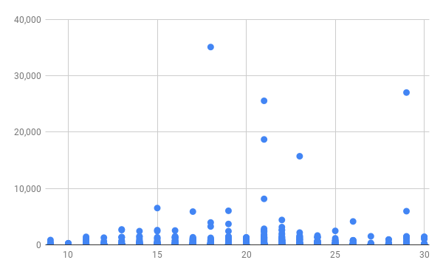
5. Do factors like weather and age impact the average bike trip duration? *
Correlation between Age Groups (horizontal axis) and Trip Duration (in minutes) (vertical axis)
Correlation between Weather Temperature (in degrees) (horizontal axis) and Trip Duration (in minutes) (vertical axis)
* Detailed explanation in the next slide.

Slide 12
5. Do factors like weather and age impact the average bike trip duration?
Initially, analysis shows that there is little correlation between the Age factor, and the Average Bike Trip Duration factor. This means that the average bike trip duration is not much influenced by the age group factor. In fact, according to the research done, most trips made are rather short (measuring the trips in minutes), independently of age.
On the other hand, we can see that there is, in fact, a high correlation between the Weather Temperature Factor and the Average Bike Trip Duration factor. We can conclude that the weather temperature directly affects the average bike trip duration of users.
Analysis shows that the most extense trip durations happen during around 20 degrees weather (from 15°to 25°, approximately). So we can conclude that as the weather temperature rises, the users make longer trips.

Slide 13
Summary

Slide 14
Summary of findings:
Top 5 pick-up locations for bikes:
Grove St Path, Sip Ave, Newport Path, Newark Ave, Van Vorst Park.
Customer base:
The average users of Citi Bikes are long-term users, that are mostly between 35 to 44 years old.
Citi Bike customer behavior:
Longest trips durations are made by the 75+ Age Group. On the other hand, the shortest trips are almost equal between the 65-74 and the 25-34 Ages Groups.
Users rent a higher number of bikes, and make the longest trips between August and March (descending on December). Correspondingly, the highest number of rents and the longest trips happen when the temperature weather is around 20 degrees.

Slide 15
Actions & Recommendations

Slide 16
Recommended actions:
Product recommendations:
Install more bikes at Grove St Path, Sip Ave, Newport Path, Newark Ave, Van Vorst Park
Make more bikes available in August to early December, and from January to March, as this is when Citi Bike users take the longest trips (which means bikes will be unavailable for longer)
Marketing recommendations:
The Citi Bike customer base is mostly long-term users, aged between 35 to 44 years old, who are most active during the weekdays. This tells us that they are probably people who live in New York and use Citi Bikes to commute. Marketing and advertising campaigns should therefore target this particular demographic.

Slide 17
Thank you!

